Slide 1
Airbnb Bookings Analysis
BY,
Bharath P

Slide 2
Introduction.
Since 2008, guests and hosts have used Airbnb to expand on traveling possibilities and present a more unique, personalized way of experiencing the world.
Today, Airbnb became one of a kind service that is used and recognized by the whole world.
Data analysis on millions of listings provided through Airbnb is a crucial factor for the company.
These millions of listings generate a lot of data - data that can be analyzed and used for security, business decisions, understanding of customers' and providers' (hosts) behavior and performance on the platform, guiding marketing initiatives, implementation of innovative additional services and much more.

Slide 3
Missing value Handling.
‘name’ = 16 null values.
‘host_name’ = 21.
‘last_review’ = 10052.
‘reviews_per_month’ = 10052
‘name’ column we will replace the ‘nan’ values with corresponding ‘room_type’ values.
‘host_name’ will not use as those are names of individuals.
'reviews_per_month' we will replace with 0 for NA values.
In ‘last_review’ We will convert its data type to categorical and replace 'NA' with 'never'.

Slide 4
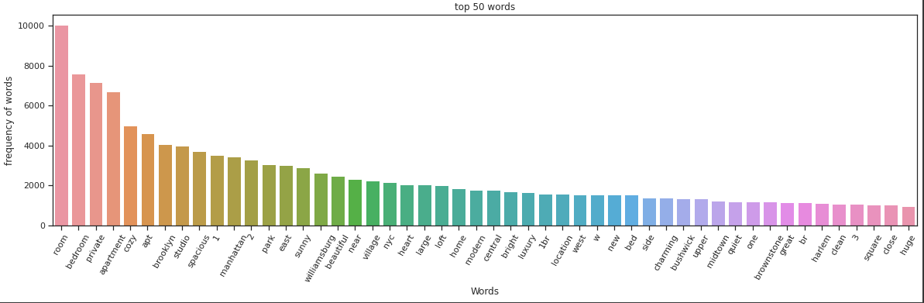
Top 50 words form Word_Cloud:

Slide 5
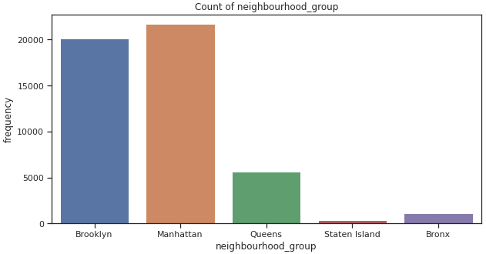
neighborhood_group

Slide 6
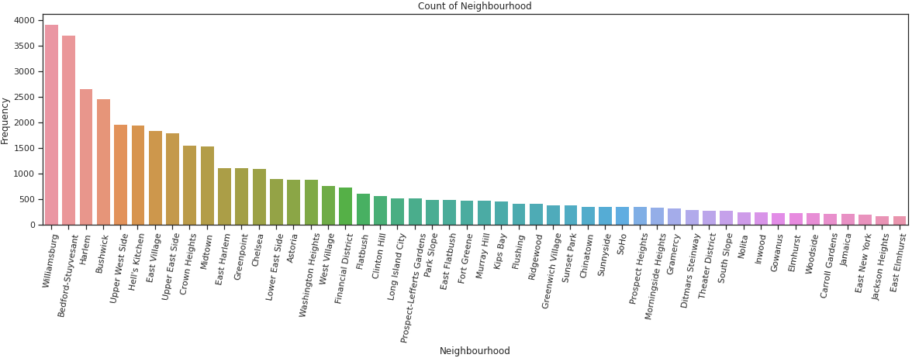
neighborhood
top 50 neighbours:
Observations:
People like to stay at these towns more offent.

Slide 7
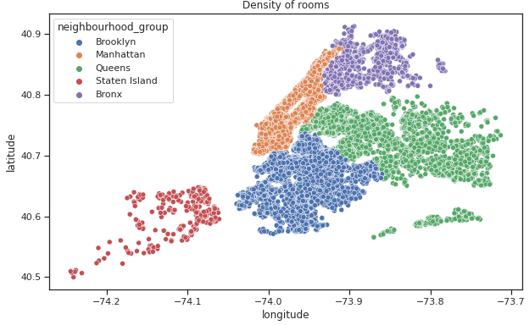
latitude & longitude

Slide 8
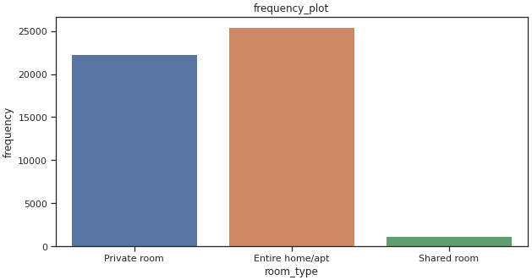
room_type
Observations:
1. There are three types of rooms
2. Namely:
1. Private room
2.Entire home/apt room_type
3. Shared room.
3. People mostly preferred to take
whole apartment on rent followed by
Private room.
4. very few people preferred to have
shared rooms.

Slide 9
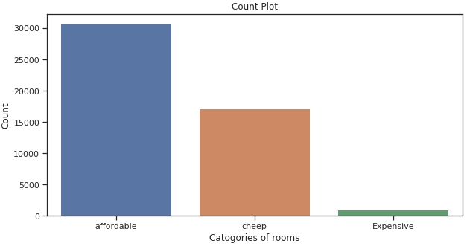
price
cheap (price range below or equal to 80$)
Affordable(for price range 80 to 500$)
Expensive(for a price range of more than 500$) so, it looks like people have more interest in having "affordable" rooms/apartments rather than having cheap and expensive rooms.

Slide 10
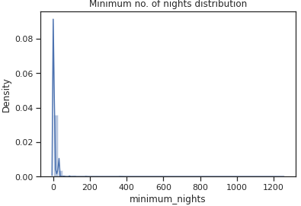
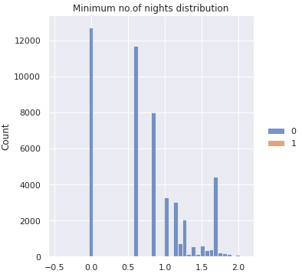
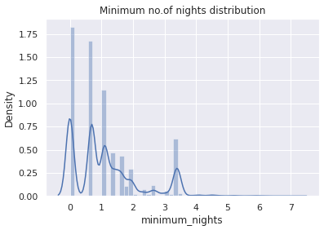
minimum_nights
Distribution Plot without
transformation:
Distribution plot after
Box_Cox transformed:
Distribution plot after
log_transform:
Observations:
we can say that the data is right-skewed so, we can do log transformation.
log_transformed plot shows that majority of room booking is one for 1 to 4 days.
we have set the lambda parameter not equal to zero.

Slide 11
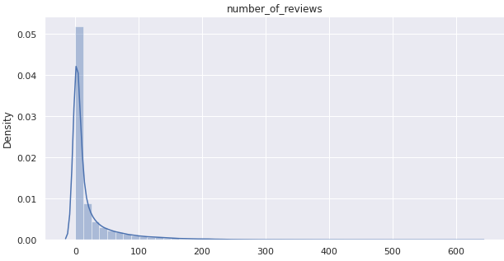
Number_of_reviews
Observations:
The number of reviews is highly dense from 0 to 100 reviews.
we can say that most of the rooms are not rated and those which are frequently occupied only those are rated.
maximum 629 times the particular room is rated.
The average rating is around 23.

Slide 12
calculated_host_listings_count
There is one host who is 327 time listed.
This is the corresponding host_id 219517861 who is having highest listing.
This is the corresponding host_id 15400695 who is having lowest listing.
last_review
max is 58 times the rating is given.
min is 0.
75% of data is for 1.5 time rating.

Slide 13
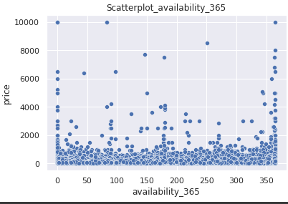
availability_365
Observations:
1. From the above plot we can see that most of the available rooms are in the price range of 0 to 2000.
2. Very few are available for a price above 2000$, this is quite obvious that there are very few peoples
who prefer to have expensive rooms.

Slide 14
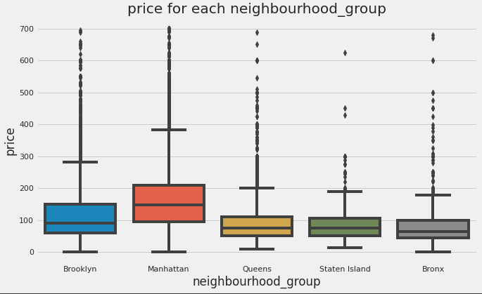
Relation between neighborhood_group
and price:

Slide 15
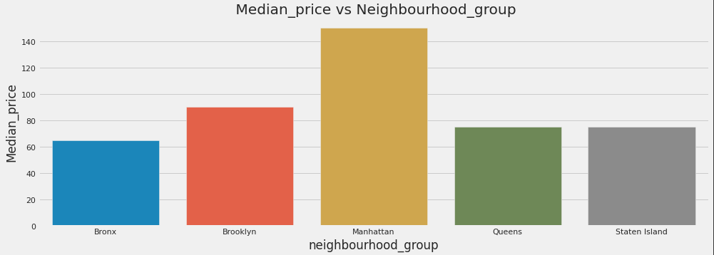
Relationship between neighborhood_group and median price

Slide 16
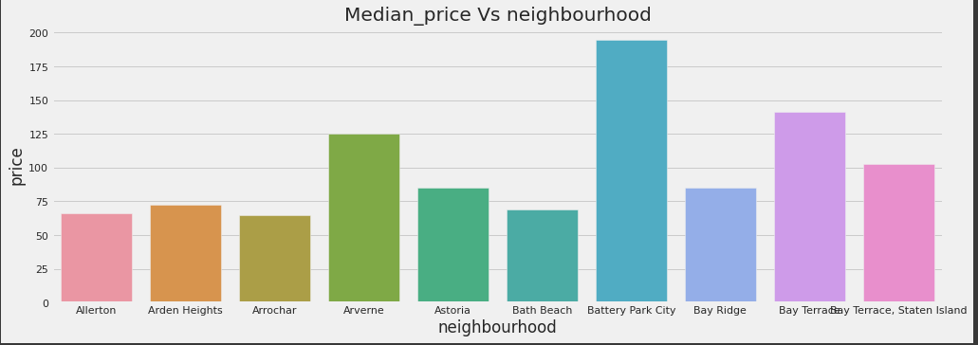
Relation between neighborhood and price

Slide 17
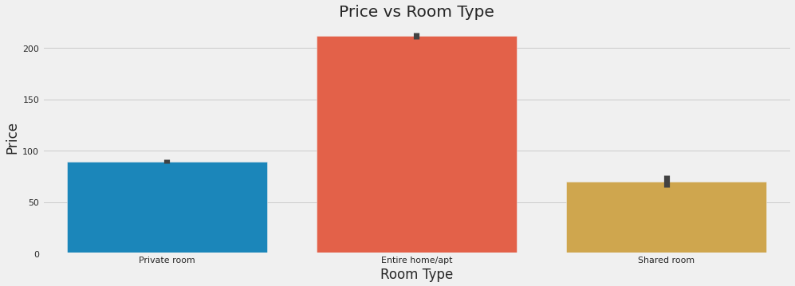
Relationship between price and room_type

Slide 18
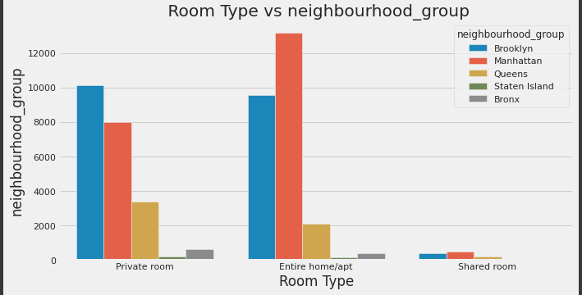
Relationship between room_type and neighborhood_group

Slide 19
Conclusion:
We tried to put some light by performing the Extensive EDA for Airbnb
dataset as always there is no end to this can be extended in
n-dimensions and lots and lots of conclusions can be drawn from EDA
This is where 80% of the time is been spent by and Data Scientist.

Slide 20
Thank you!!

